Slide 1
ORGANIZATIONAL DEVELOPMENT
Dr. Srinibash Dash
Associate Professor & Head
School of Management
Gangadhar Meher University
)

Slide 2

CONTENTS
INTRODUCTION OF OD
OBJECTIVES OF OD
NATURE OF OD
INTERVENTIONS OF OD
PROCESS
CASE STUDY
CONCLUSION

Slide 3
INTRODUCTION
1.Organizational development focused on understanding and managing organizational change.
2. It is a systematic learning and development strategy to change the basic of beliefs , attitude and structure of current organization to better absorb disruptive technologies,market opportunities and ensuring challenges and choas

Slide 4

OBJECTIVES
1.Increase the level of inter- personal trust among employees.
2. Increase employee's level of satisfaction.
3. To confront problems instead of neglecting them.
4. Effectively manage conflict.
5. Increase cooperation among the employees.
6. Increase the organization problem solving.

Slide 5
NATURE OF OD
Planned Change Process: OD involves intentional, well-thought-out efforts to bring about change within an organization.
Focus on Human Systems:OD emphasizes the role of people in organizations. It prioritizes enhancing employee satisfaction, motivation, and collaboration while aligning individual goals with organizational objectives.
Systemic Approach: OD views organizations as systems made up of interrelated parts.
Long-Term Orientation: OD focuses on sustainable development and long-term improvements in organizational culture, processes, and performance.
Change in Culture and Behavior: OD targets both tangible (structures, policies) and intangible (beliefs, values) aspects of organizations.

Slide 6
INTERVENSIONS OF OD
Interventions are structured activities or strategies used in Organizational Development (OD) to improve organizational effectiveness and address specific challenges.
1. Human Process Interventions: Focus on interpersonal relationships, communication, and group dynamics to improve collaboration and teamwork.
2. Technostructural Interventions: These address organizational structures and technologies, focusing on aligning them with business goals
3. Human Resource Management (HRM) Interventions: Focus on improving HR practices to better support employees and align them with organizational goals.
4. Strategic Interventions: Address broader organizational strategies to ensure the organization adapts to its external environment effectively.
5. Organizational Transformation Interventions: Designed to create large-scale change and transform the organization.

Slide 7
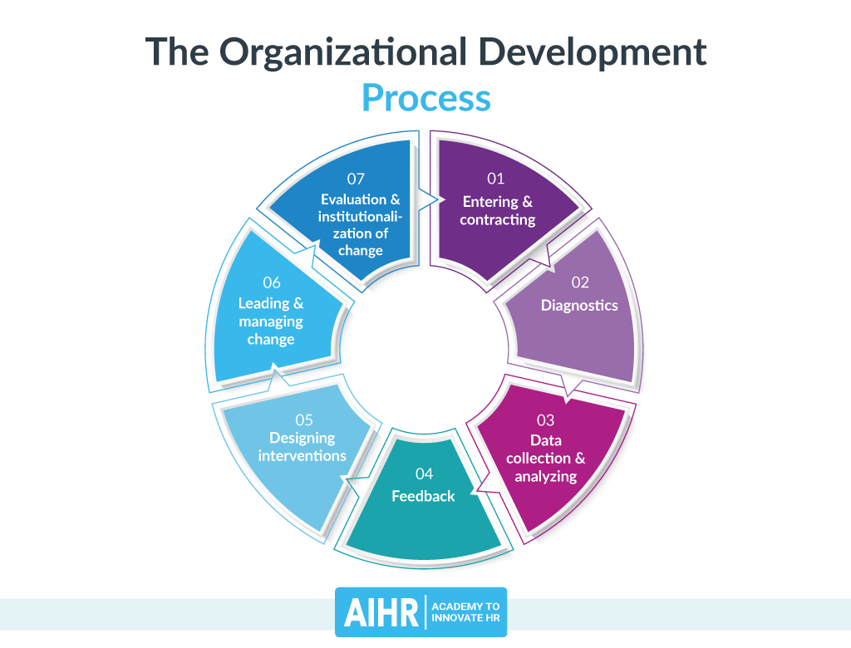
PROCESS OF OD
Needs assessment: The OD practitioner conducts a preliminary needs assessment to identify the organization's challenges and goals.
Goal setting :The OD practitioner gathers data analyzes it and sets the goals according to the requirement in the area of improvement.
Intervention selection :The OD practitioner and the organization's stakeholders collaborate to design and plan interventions to address the identified challenges and goals

Slide 8
Implementation: The OD practitioner and the organization's stakeholders implement the planned interventions, which may include training, coaching, team building, and process improvements.
Evaluation: The OD practitioner and the organization's stakeholders conduct a comprehensive evaluation of the OD process and its outcomes.

Slide 9
Case Study:
Tata Group's Organizational Development Background:
The Tata Group, one of India's largest and oldest conglomerates, has consistently evolved its organizational structure to stay competitive and innovative.
Founded in 1868, it operates in diverse industries like steel, automobiles, IT, and consumer goods.
Challenges :Managing diverse businesses across global markets.
Adapting to changing technology and customer needs.
Ensuring alignment of leadership across its many companies.

Slide 10
Key Organizational Development
1. Professionalization of Management: The Tata Group moved from family-led management to hiring professional leaders, ensuring expertise-driven decision-making.
2. Decentralization: Each Tata company operates independently but aligns with the group’s values and strategic vision. This empowers leaders while maintaining accountability.
3. Emphasis on Innovation: Tata invested in R&D, leading to projects like the Tata Nano (the world’s most affordable car) and advanced IT services through TCS (Tata Consultancy Services).

Slide 11

RESULTS
Growth into a global brand, operating in over 100 countries.
Consistent alignment with values like social responsibility, innovation, and customer focus.
Successful ventures, including TCS, Tata Motors, and Tata Steel, driving India's economic growth.

Slide 12
CONCLUSION
Organizational Development is a planned, organization-wide effort to improve organizational effectiveness and health.
OD is a critical component of organizational success, and its principles and practices can be applied to a wide range of organizations and contexts

Slide 13

THANK YOU

